Slide 1
Classification of Diabetes Health Indicators
Submitted in the partial fulfillment for the award of the degree of
BACHELOR OF ENGINEERING
IN
Artificial Intelligence & Machine Learning
Submitted by:
Aryan Kushwaha (20BCS6691)
Ankith Raj (20BCS6684)
Aryan Gupta (20BCS6656)
Vaibhav Kumar Singh (20BCS3842)
Under the Supervision of:
Dr. Amit Vajpayee(E14118)
DISCOVER . LEARN . EMPOWER

Slide 2
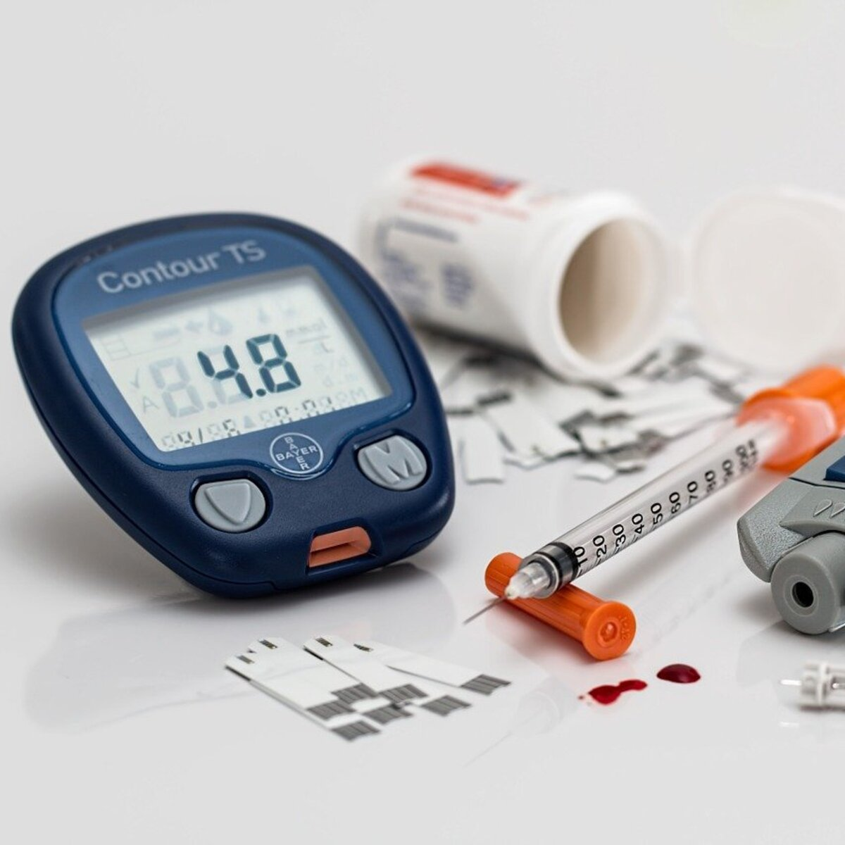
Why Opted this project?
Opting for a project on Understanding Diabetes Health Indicators is imperative due to its significant societal impact. Diabetes affects millions worldwide, with rising prevalence rates.
Understanding its types and indicators enables proactive health management and prevention strategies.
Moreover, educating individuals about diabetes fosters early detection, better management, and reduced complications.
By addressing this crucial health concern, we contribute to enhancing public health outcomes and quality of life.

Slide 3
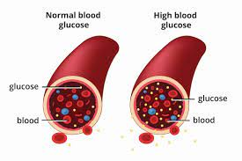
Introduction
Diabetes is a chronic health condition characterized by the body's inability to effectively convert food into energy.
It occurs when pancreas creates insulin in excess or unable to create insulin to meet the requirements.
In such cases body becomes deficit of insulin and diabetes occurs.
It results from either insufficient insulin production or the body's inability to use insulin properly.
Diabetes are divided into different types.

Slide 4
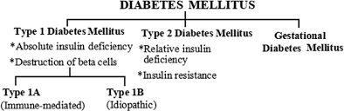
Types of Diabetes

Slide 5
Objective
In this project, the objective is to predict whether the patient has diabetes or not based on various features like Glucose level, Insulin, Age, BMI. Will perform all the steps from Data gathering to Model deployment.
During Model evaluation, compared various machine learning algorithms on the basis of accuracy score metric and find the best one. Then created a web app using Flask which is a python micro framework.
The goal is to promote early detection, effective management, and prevention of diabetes-related complications, leading to improved health outcomes for individuals and communities.

Slide 6
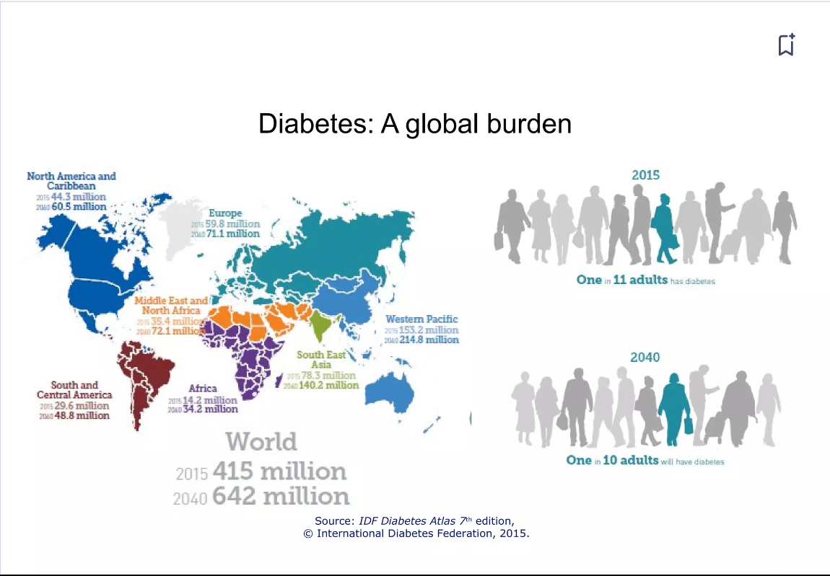

Slide 7
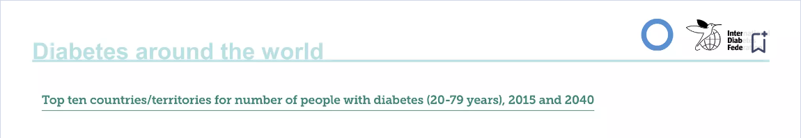
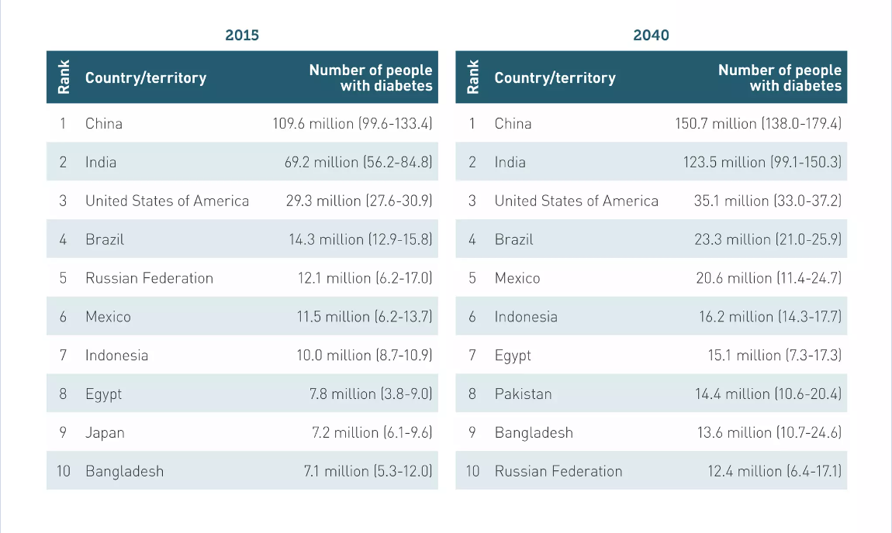

Slide 8
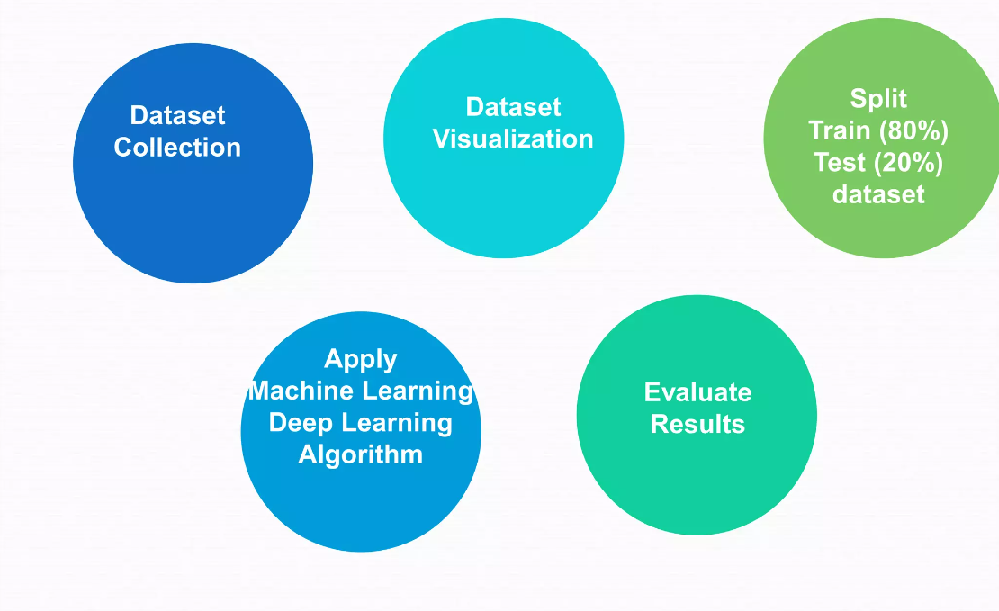
Methodology

Slide 9
Methodology
The methodology for the diabetes prediction project involves data collection from reliable sources, including medical records and lifestyle factors. Preprocessing includes data cleaning and feature selection.
Model selection involves comparing algorithms like logistic regression, decision trees, and neural networks.
Evaluation metrics such as accuracy, precision, recall, and F1 score are used for model performance assessment.
Finally, the model undergoes validation and fine-tuning for optimal predictive accuracy.

Slide 10
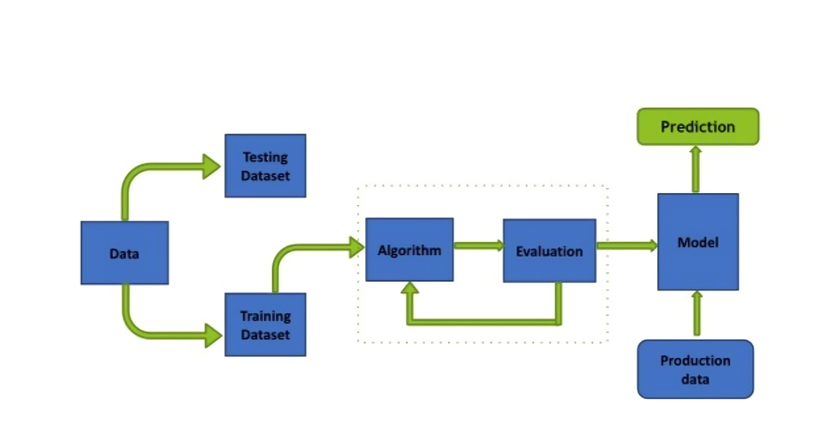
Block Diagram

Slide 11
Machine Learning Workflow
We can define the machine learning workflow in 5 stages:
Gathering data
Data pre-processing
Research the model that will be best for the type of data
Training and testing the model
Evaluation

Slide 12
Flowchart
Data Collection and
Pre-Processing
Feature Selection and Engineering
Model Selection
Model Training and Evaluation
Deployment and Monitoring
Model Interpretability
Hyperparameter Tuning

Slide 13
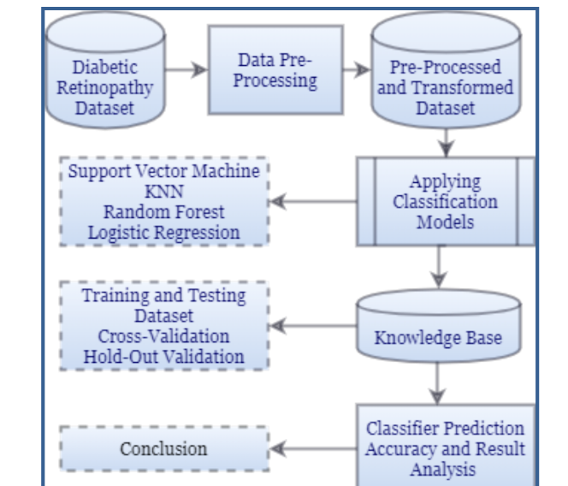
Proposed model for prediction and Evaluating outcome

Slide 14
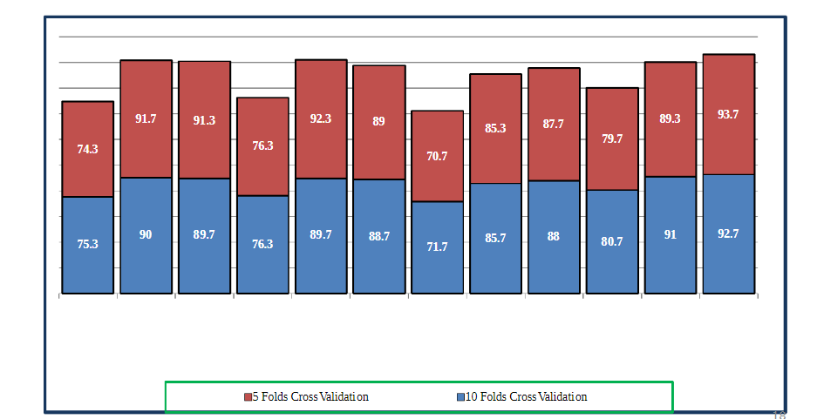
Result Analysis
For:10 Folds Cross Validation and 5 Folds Cross Validation -PCA Applied for Number of Components to be 6, 7 and 8 on all algorithms.

Slide 15
We can see that bagged trees when applied with 5 fold cross validation with 8 principal components gives us the best accuracy of 93.7% and with10 folds, gives 92.7% accuracy.
The reason behind this result is, when bagging with decision trees, we are less concerned about individual trees overfitting the training data.
For this reason and for efficiency, the individual decision trees are grown deep (e.g. few training samples at each leaf-node of the tree) and the trees are not pruned.
These trees will have both, high variance and low bias.
These are important characteristics of sub-models when combining predictions using bagging.

Slide 16
Conclusion
In this paper machine learning methods are used for the prediction of Diabetic Retinopathy in patients, using their health records of diabetes.
These health records were organized in a structured way by eliminating noisy data. With the help of machine learning algorithms, knowledge is extracted from these records in the form of numerical values for the prediction of DR. Then four types of machine learning models were used to find out the results.
To find out the best parameters for our prediction model and overfitting, two types of validation are applied: Cross Validation and Hold-out validation on our dataset. In this paper, records of 300 patients form our experimental dataset.
In our case, 10 folds and 5 folds cross validations are used. Also, for hold-out validation, we have applied 10% and 20% hold out. Along with this, to improve the algorithmic performance, Principal Component Analysis (PCA) with 6, 7 and 8 principal components has also been tested.

Slide 17
Future Scope
The future scope of involves leveraging advanced research and technology, expanding community outreach, emphasizing preventive health strategies, fostering global collaboration, and investing in research and education initiatives.
By embracing these opportunities, we can enhance diabetes prevention, management, and global health outcomes, paving the way for a future where diabetes is better understood, effectively managed, and ultimately prevented.

Slide 18
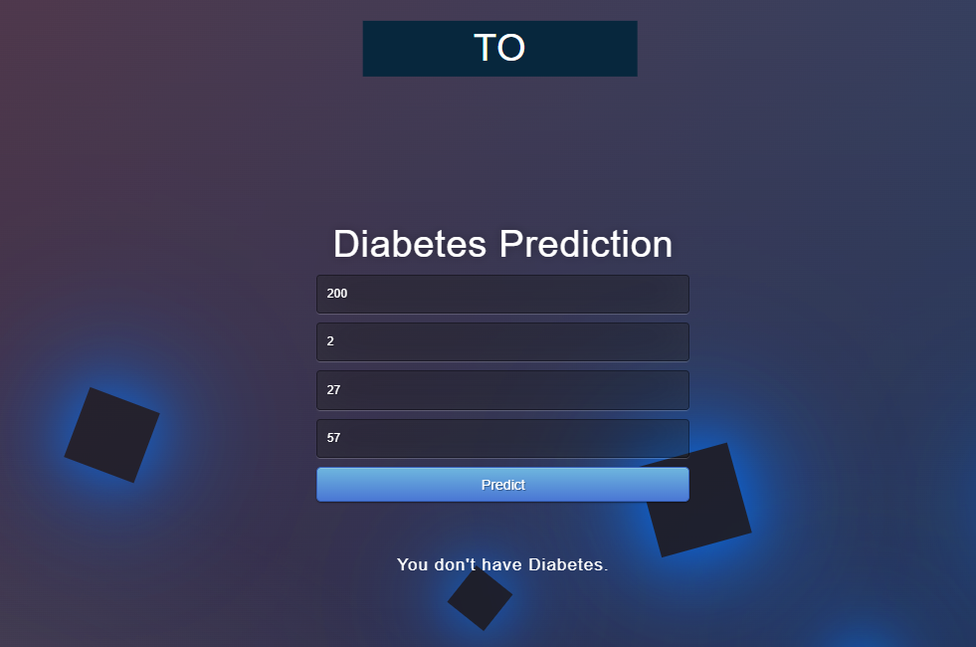
Result

Slide 19
References
Medical journals like JAMA, The Lancet, and Diabetes Care.
studocu.com/in/document/indraprastha-institute-of-information-technology-delhi/computer-sciences-and-applied-mathematics/projectreport-diabetes-prediction/30748724
Academic institutions with research departments focusing on diabetes, such as the American Diabetes Association (ADA).
Books authored by respected experts in the field of endocrinology and diabetes management.
Online resources like Mayo Clinic, WebMD, and Medscape, ensuring they are peer-reviewed and evidence-based.

